Slide 1
Tensorflow Basic (2/2)

Slide 2
Optimization basic
Training for prediction
Y : a set target variable
X : a set of feature vector to explain Y
Model selection to best capture the desired relation of X and Y
Linear regression, logistic classification, deep neural network, …
Our training data points will be used for tuning the model

Slide 3
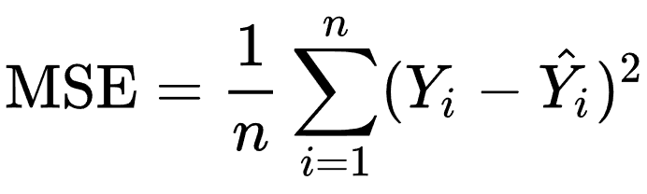
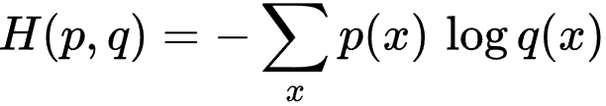
Optimization basic
Defining a loss function
A good measure is required to evaluate the model’s performance.
Measure the discrepancy or distance (loss) between the model’s predictions and the observed targets.
The goal of optimization is to find the set of parameters (weight, biases, …) of the model that minimize the distance.
Mean squared error
Cross entropy error

Slide 4
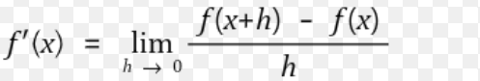
Optimization basic
Gradient descent: Finding the set of X that minimizes or F(X).
Derivative :
Partial derivative, ∇
y = f(x₁, x₂, x₃, …., x_{n}), ∇f = (f_{x1}, f_{x2}, f_{x3}, …., f_{xn})
Gradient descent
x’ = x – ε * ∇f ε: learning rate

Slide 5
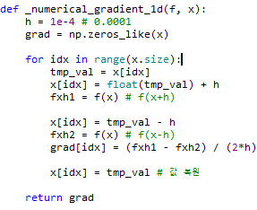
Optimization basic
* Gradient descent optimizer
f: loss function
x: parameters to tune
Iteratively update the set of parameters in a way that
decrease the loss over time.
But the point we find could be a global minimum or a saddle point.
→ Second derivative

Slide 6
Optimization basic
Stochastic gradient descent
Instead of feeding the entire dataset to the algorithm for the computation of each iteration, a subset of the data is sampled (mini-batch) and fed.
Using smaller batches usually works faster and the smaller the size of the batch, the faster are the calculations. However, there is a trade-off in that small samples lead to lower hardware utilization and tend t have high variance, causing large fluctuations of the objective function.
Nevertheless, it turns out that some fluctuations are beneficial since they enable the set of parameters to jump to new and potentially better local minima.
Using a relatively small batches is preferred recently.

Slide 7
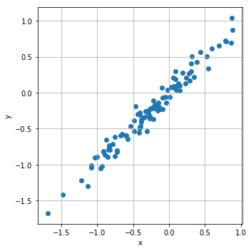
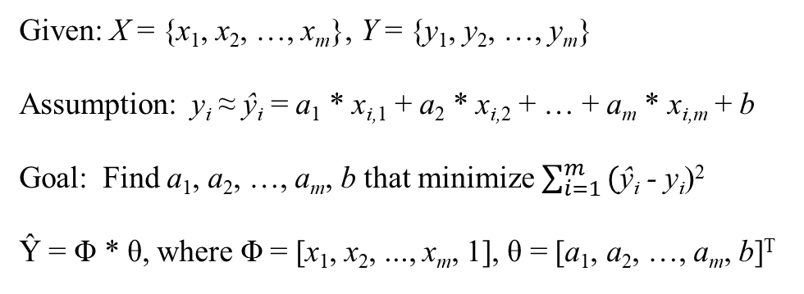
Linear regression
Given: X = {x₁, x₂, …, x_{m}}, Y = {y₁, y₂, …, y_{m}}
Assumption: y_{i} ≈ ŷ_{i} = a₁ * x_{i,1} + a₂ * x_{i,2} + … + a_{m} * x_{i,m} + b
Goal: Find a₁, a₂, …, a_{m}, b that minimize $\sum_{i=1}^{m}{\text{(}\text{ŷ}\text{i}\text{ - }\text{y}\text{i}\text{)}\text{2} }$
Ŷ = Φ * θ, where Φ = [x₁, x₂, ..., x_{m}, 1], θ = [a₁, a₂, …, a_{m}, b]^{T}
a₁
a₂
…
a_{m}
b
[x_{1,1}, x_{1,2}, ..., x_{1,m}, 1]
[x_{2,1}, x_{2,2}, ..., x_{2,m}, 1]
...
[x_{n,1}, x_{n,2}, ..., x_{n,m}, 1]
Ŷ =
*
= Φ * θ

Slide 8
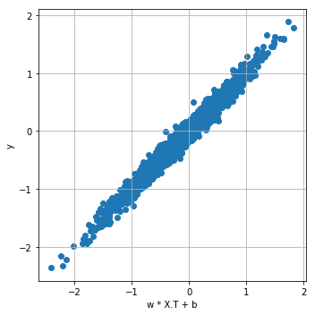
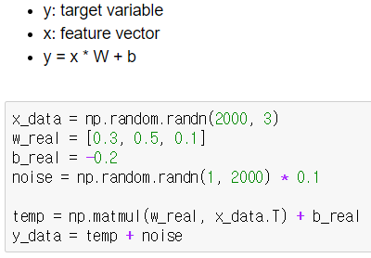
Linear regression with Tensorflow
1. Data generation

Slide 9
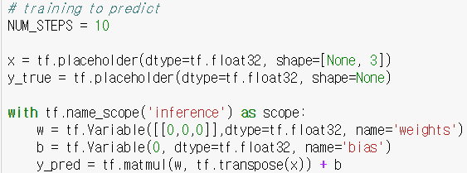
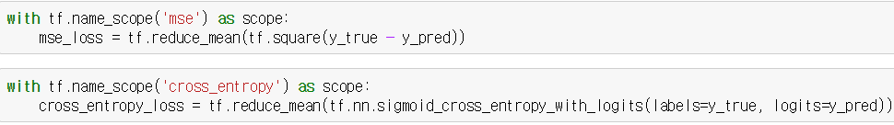
Linear regression with Tensorflow
2. Model definition
3. Loss function definition

Slide 10
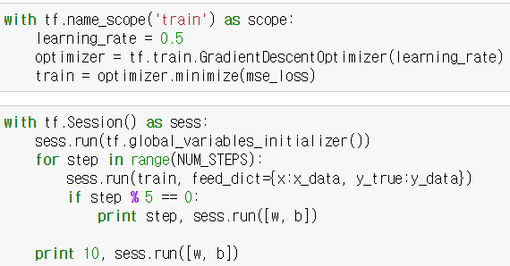
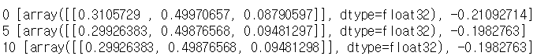
Linear regression with Tensorflow
4. Training
5. Result

